Slide 1

Digital Playgrounds: A Snapshot of Today's Gaming Industry
Group 5:
Yaoming Jiang, Juliette Larmuseau, Swarnim Mudaliar, Svenja Nitschke, Radhika Taneja, Albert Xu
Notes:
1 Video Game market overview
2. Deepdive on console market
3. deeper look into products
4. PS4/PS5
5. console sales progress over time
6. video games made specifically for PS, talk about the major series made specifically for playstation
7. transition to professional e-sports

Slide 2
Data Sources
Video Game Sales
"vgsales.csv"
Scraped from
vgchartz.com
This dataset contains a list of video games with sales greater than 100,000 copies
List of Best-Selling Game Consoles
Scraped from Wikipedia.com
The data contains video game consoles that have sold at least 1 million units worldwide
Worldwide PS4 & PS5 Software Unit Sales
Scraped from SonyInteractive.com
The data contains unit sales for PlayStation®4 & PlayStation®5
Largest Overall Prize Pools in Esports
Scraped from EsportsEarnings.com
This list represents video game tournaments with the largest prize pools in esports

Slide 3

Part I: The Market

Slide 4
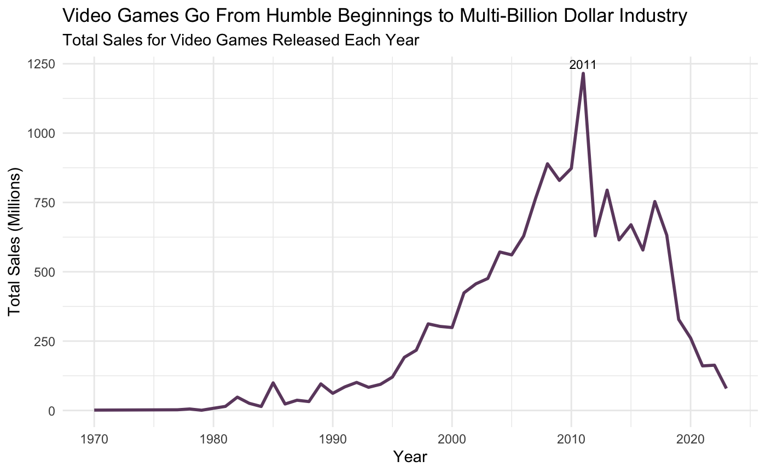
What does the market look like? A Global Market Overview
Video game sales decline due to rising mobile game popularity
Microsoft and Sony respond to the mobile-gaming trend by offering cloud-based subscriptions for multi-device access
The gaming industry must adapt to changing preferences and tech trends, driven by smartphones, social media games, and streaming services
Market
Players
Career
Notes:
Video Game market overview
TITLE:
Inflection Point: Video Game Sales Descend After 2011 Peak

Slide 5
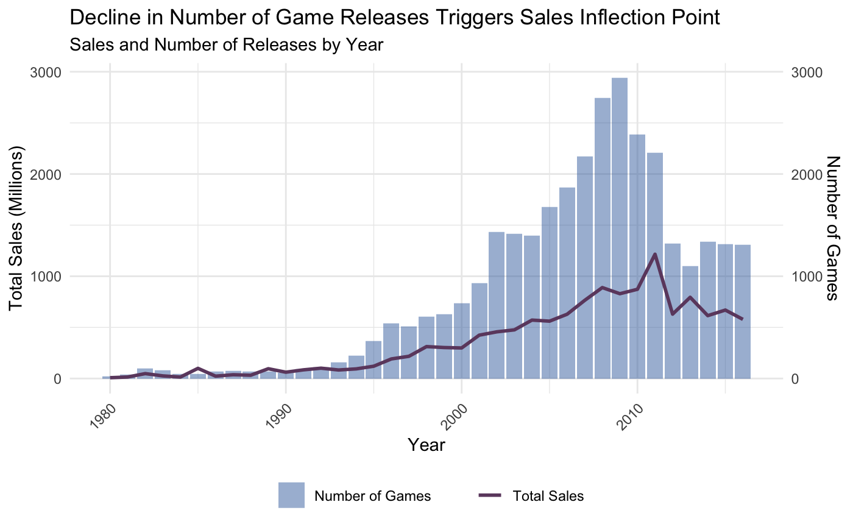
What explains the sharp downward turn post 2011? Sudden Level Down in Game Releases: The Likely Culprit
Market
Players
Career
Notes:
Video Game market overview
TITLE:
Inflection Point: Video Game Sales Descend After 2011 Peak

Slide 6
Who led this trend? Part II: The Players

Slide 7
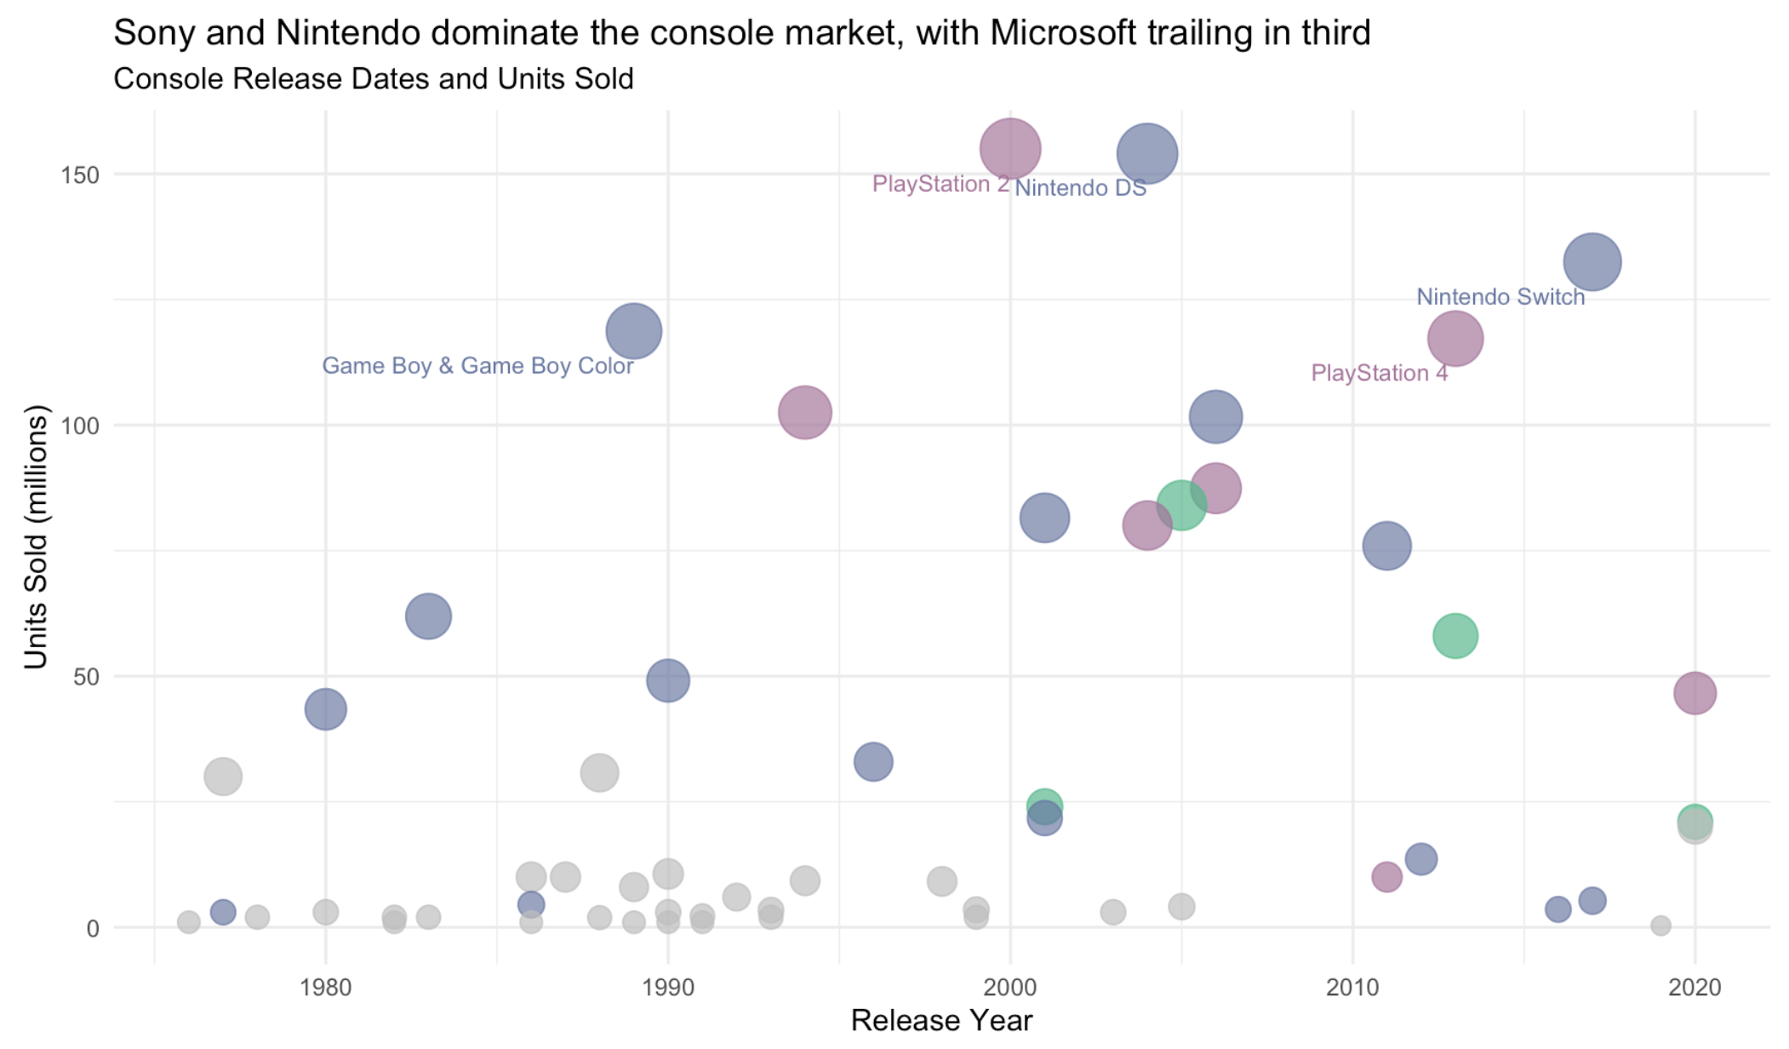

Who are the key companies in the console market? Console Wars: The Battle for Market Dominance
Market
Players
Career

Slide 8
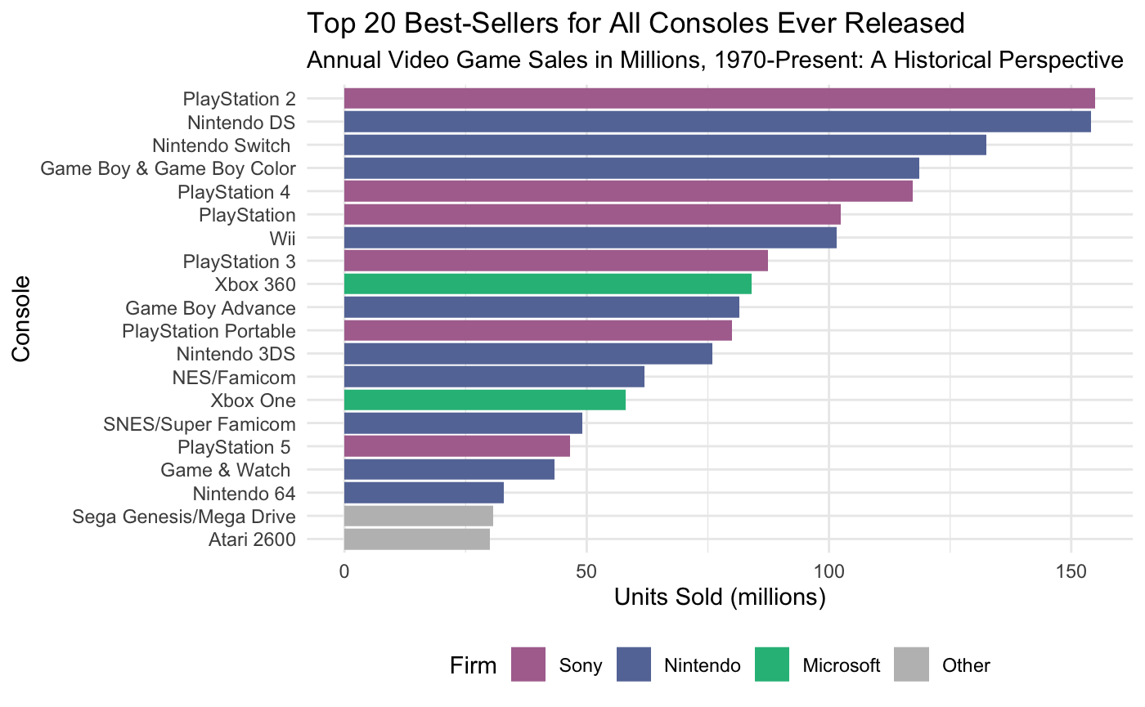
Let's investigate the makeup of the console market... Triumvirate of Tech: Decade-Long Dominance in the Console Market
Market
Players
Career
Notes:
Subtitle: Showcasing the Top 20 Best-Selling Consoles with Unit Sales in Millions
Title: Sony and Nintendo Lead the Charge in Console Sales

Slide 9
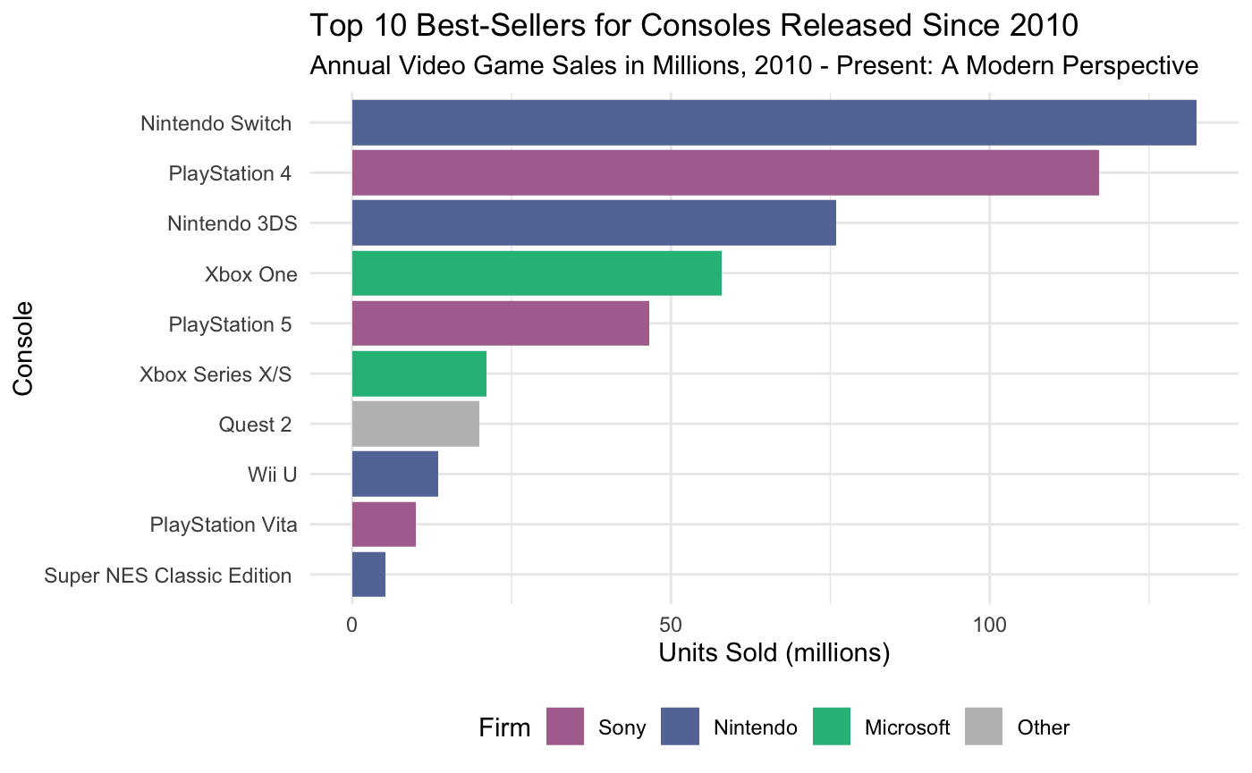
Let's take a closer look... The Sony-Nintendo Rivalry Defines a Decade
Market
Players
Career
Notes:
We see that PS4 still has the highest sales even though PS5 is released. Likely because PS4 has been in the market for longer. NOW let's take a look at whether the introduction of PS5 reduced sales of PS4 at all... Title: Dominance of the Nintendo Switch and PlayStation 4 in last decade Subtitle: Top 10 Best-Seller Consoles from 2010-2020 by Units Sold

Slide 10
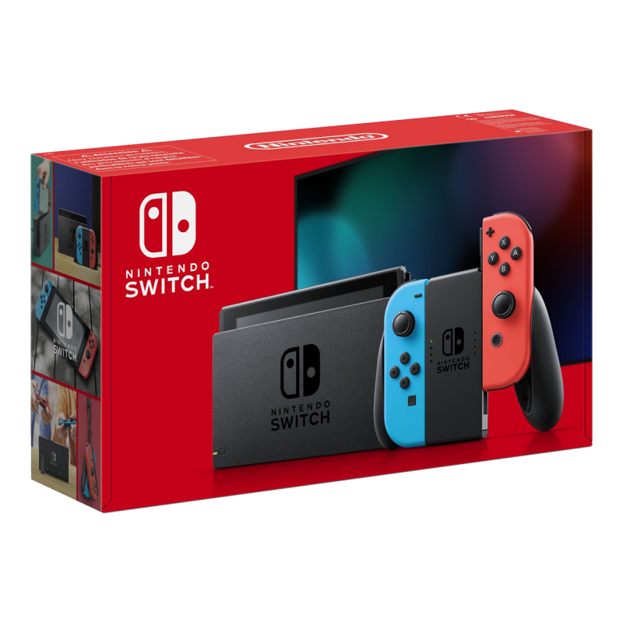
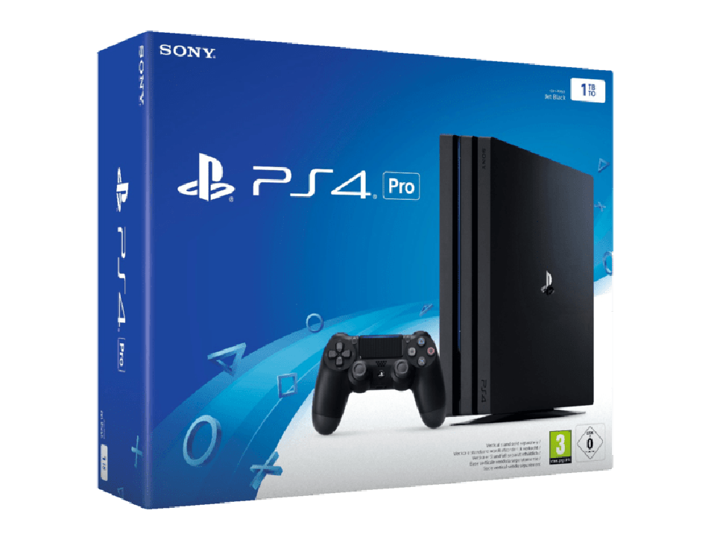
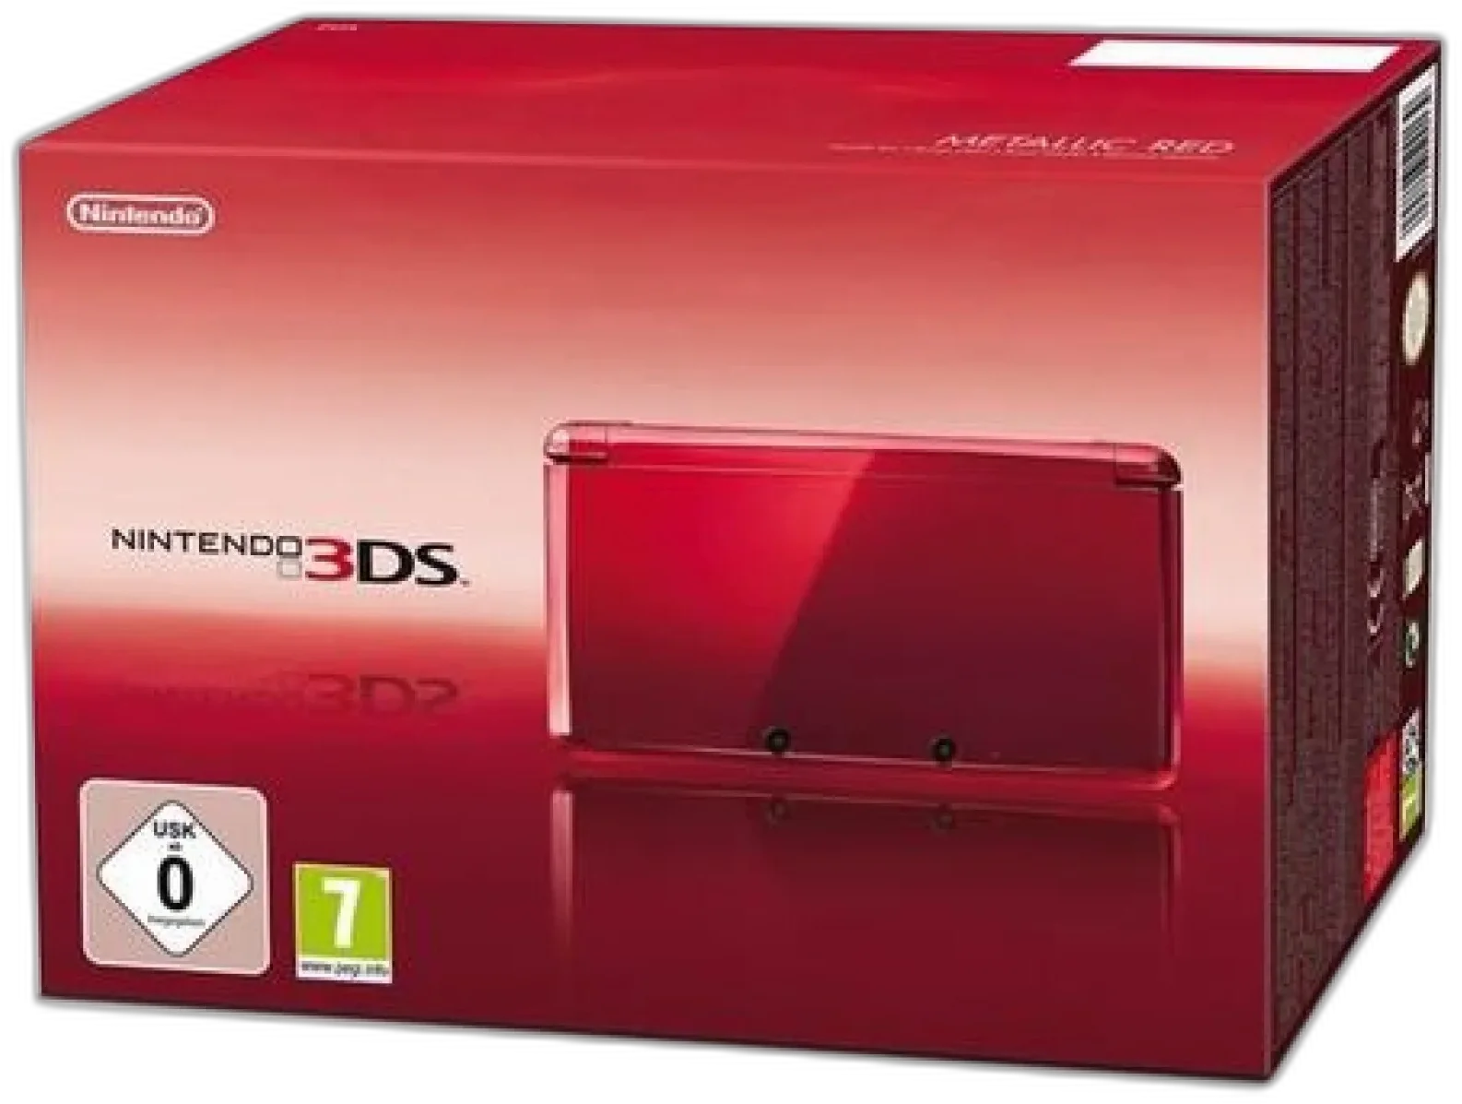
Showcasing Japan's Pioneering Consoles That Revolutionized the Global Gaming Market Decade's Defenders: Stalwarts of the Console Market
Nintendo Switch
PlayStation 4
Nintendo 3DS
Launched in 2017
Price: $299.99
Launched in 2013
Price: $399.99
Launched in 2011
Price: $249.99
Market
Players
Career

Slide 11
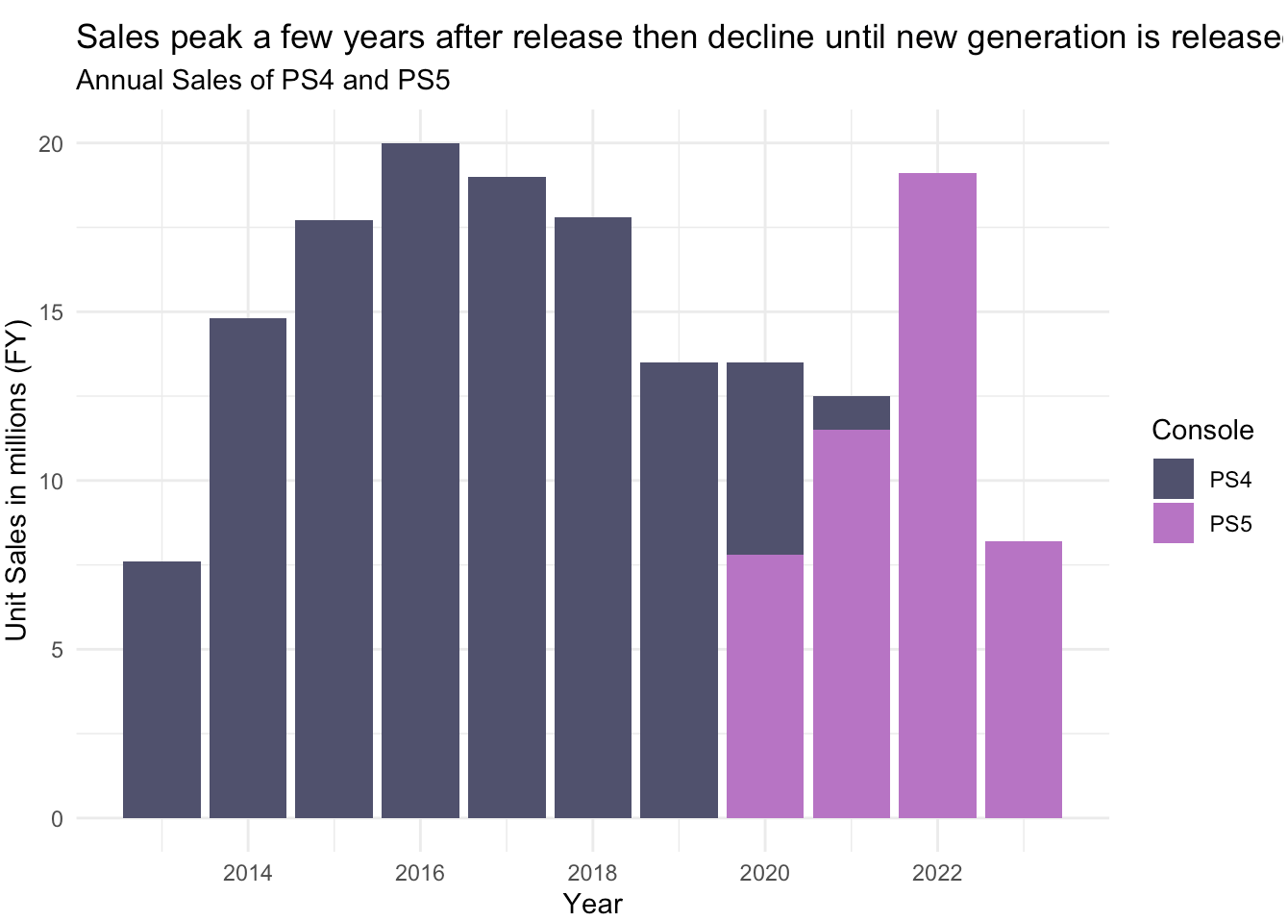
How do newer versions impact sales? The PlayStation Legacy: PS4 and PS5's Market Impact
Market
Players
Career
Notes:
4. PS4/PS5

Slide 12
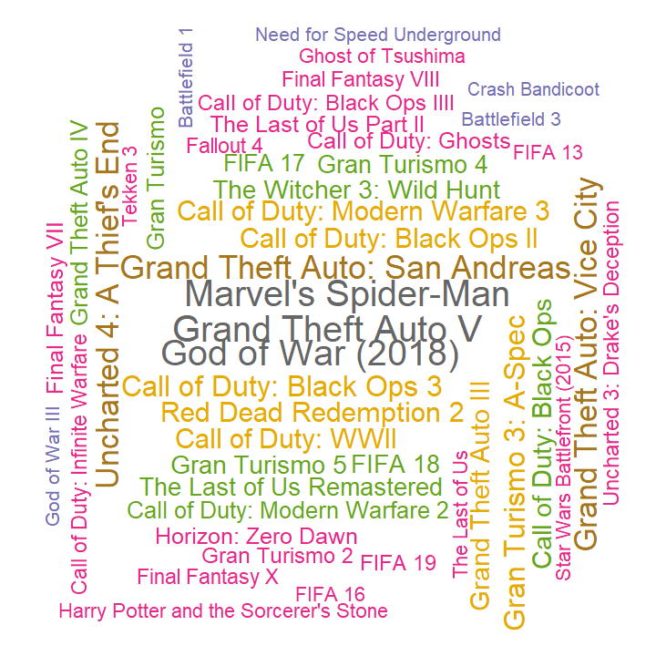

What are PlayStation's most popular games? Diving into the PlayStation Universe: A Spectrum of Blockbusters
PlayStation’s most popular games – An illustration
Top 50 games by sales for PlayStation
Popularity is evenly spread
Franchises like 'Call of Duty' and 'FIFA' show recurring success, indicating strong brand loyalty
Many games offer robust online multiplayer features, reflecting the social shift in gaming
How many of these have you played before?
Market
Players
Career

Slide 13
What opportunities lie in this industry? Part III: The Career

Slide 14
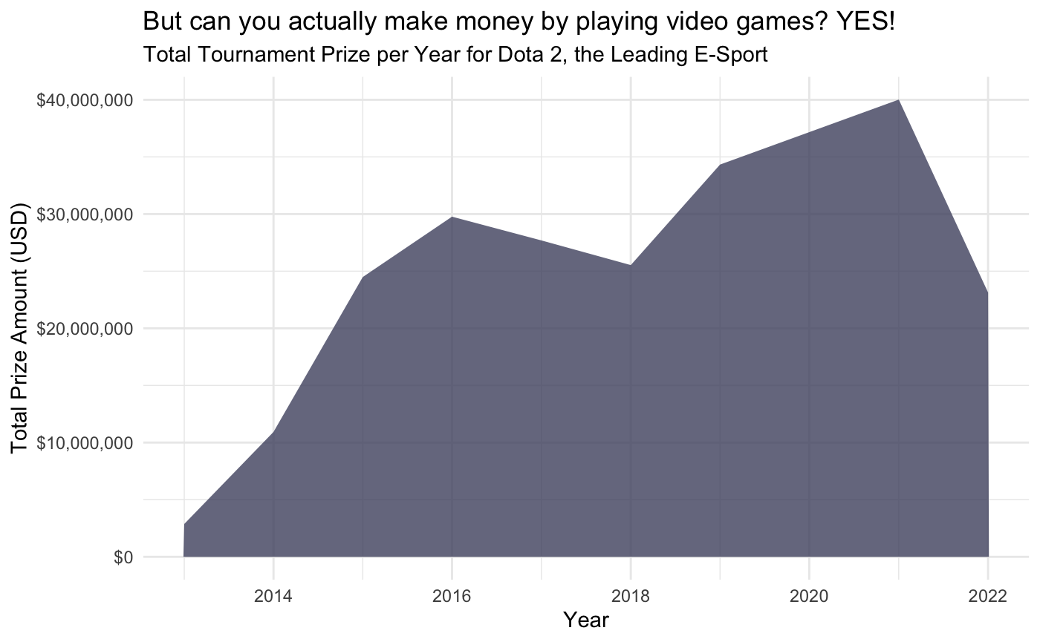
Wait, but what about professional gaming? From Living Room to Arena: The Rise of Professional E-Sports
Market
Players
Career
Notes:
6. transition to professional e-sports
7. Dota 2 prizepool domination

Slide 15
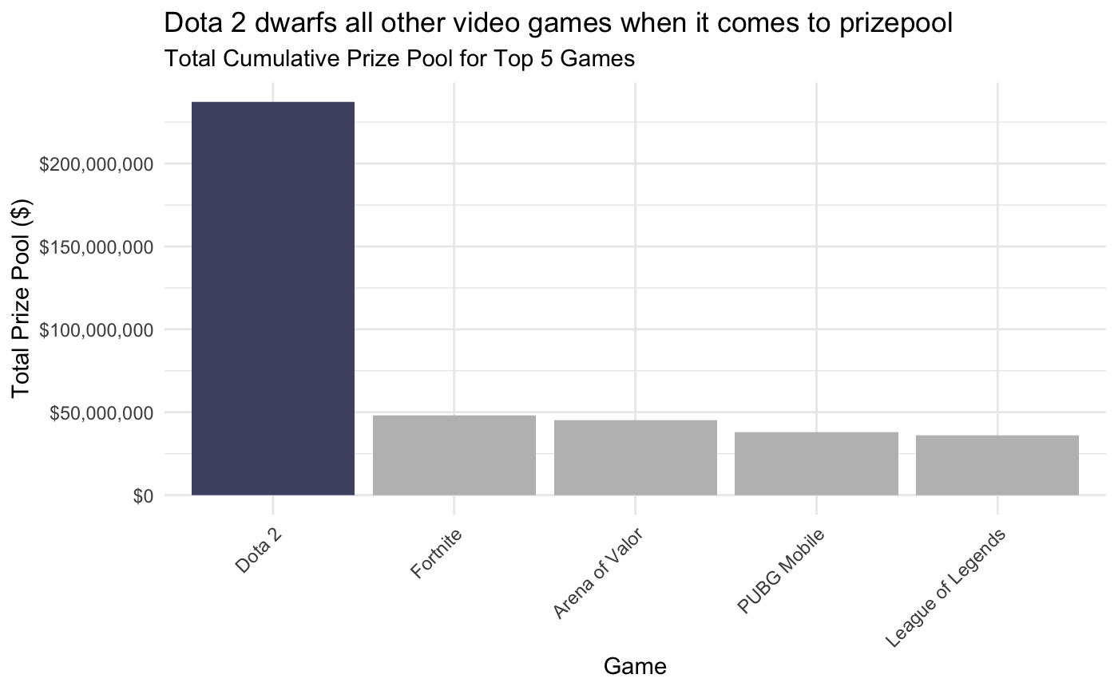
Wait, but what about professional gaming? From Living Room to Arena: The Rise of Professional E-Sports
Market
Players
Career
Notes:
6. transition to professional e-sports
7. Dota 2 prizepool domination

Slide 16
Limitations & Conclusion
THANK YOU!
Limitations
Datasets do not comprehensively cover all segments of the gaming industry (e.g., mobile, console, PC, and emerging platforms like VR)
Gaming industry is highly dynamic, with trends and consumer preferences changing swiftly. Data collected even a few months ago might not accurately reflect current market conditions or forecast future trends effectively

